Slide 1
Topic: Multiplication EQ: How do I multiply fractions?
Year 7 Mathematics
Mrs Parlevliet

Slide 2
Contents
Glossary or Formula Page
Page
Date
Essential Question
24
7
30
Word or Formula
Definition or Example

Slide 3
Tasks
24
7
30
Topic
Essential Question
Questions
Notes
Summary
1
2

Slide 4
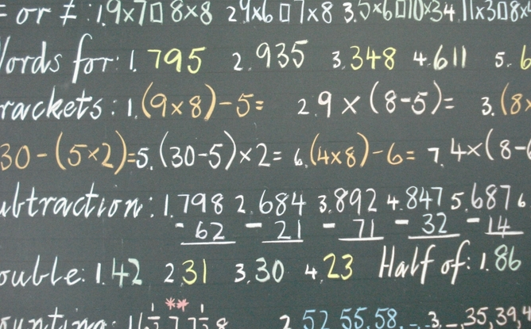

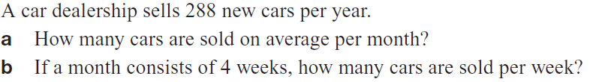

Five Questions (LHS)
Topic: Multiplication EQ: How do I multiply fractions?
Date: 26/03/2021
Calculate $−5×−1×−2$
Evaluate without a calculator $3×53=$
List in ascending order: $\frac{1}{3},\frac{1}{5},\frac{1}{2},\frac{1}{10}$
A small pizza is sliced in half to share between Seb and Bobbi. Bobbi says that she only wants half of half slice of pizza? How much pizza does Bobbi want?
This Photo by Unknown Author is licensed uder CC BY-ND
Notes:
-10
159
$\frac{1}{10},\frac{1}{5},\frac{1}{3},\frac{1}{2}$
$\frac{1}{4}$ of the pizza
a) 24 cars per month b) 6 cars per week

Slide 5



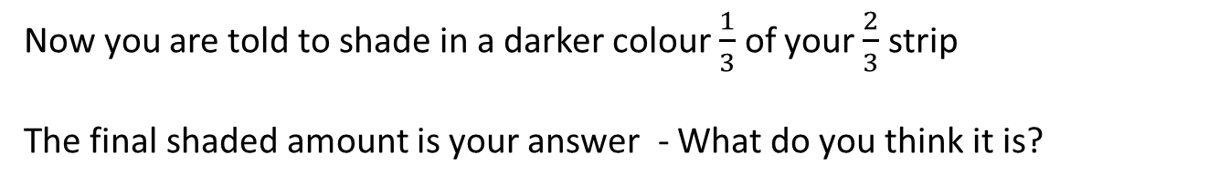
24
7
30
Topic: Multiplication
Date: 26/03/2021
EQ: How do I multiply fractions?
The Fraction Strip Method
Example 1: $\frac{2}{3}×\frac{1}{3}$
A piece of paper divided into thirds. You shade $\frac{2}{3}$ of the fraction strip.
Now you are told to shade in a darker colour $\frac{1}{3}$ of your $\frac{2}{3}$ strip
The final shaded amount is your answer - What do you think it is?
$$\frac{2}{9}$$
Notes:
Write the outcome on the board $\frac{1}{3}×\frac{2}{3}=\frac{2}{9}$
Do this for each method to see if any kids get the ‘pattern’ before the written method.

Slide 6


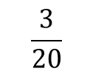

TASK (LHS) Evaluate $\frac{1}{5}×\frac{3}{4}$
1. Shade in $\frac{3 }{4 }$ of a fraction strip
2. Now shade in a darker colour $\frac{1}{5}$ of your $\frac{3}{4}$ fraction strip
The final shaded amount is your answer - What do you think it is?
$$\frac{3}{20}$$
Notes:
Write the outcome on the board $\frac{1}{5}×\frac{3}{4}=\frac{3}{20}$
Do this for each method to see if any kids get the ‘pattern’ before the written method.

Slide 7


Slide 8

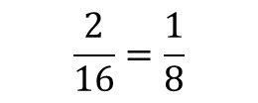
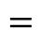

24
7
30
Topic: Multiplication
Date: 26/03/2021
EQ: How do I multiply fractions?
The Shading Method
Consider $\frac{1}{4}$ multiplied by $\frac{2}{4}$
$$×$$
$$=$$
The overlap area is the answer – what is the value?
$$\frac{2}{16}=\frac{1}{8}$$
Notes:
Write the outcome on the board $\frac{1}{4}×\frac{2}{4}=\frac{2}{16}=\frac{1}{8}$
Do this for each method to see if any kids get the ‘pattern’ before the written method.

Slide 9


Are there any patterns between the fractions being multiplied and the answer fraction?

Slide 10

Multiplyin’ Fractions – Murf Math https://www.youtube.com/watch?v=4ghdmifxufe

Slide 11
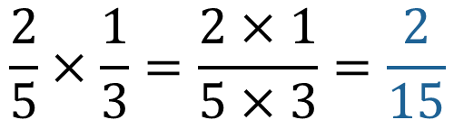
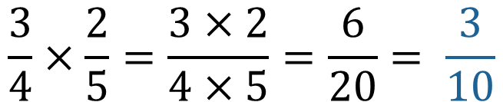
24
7
30
Topic: Multiplication
Date: 26/03/2021
EQ: How do I multiply fractions?
The Rule or Algorithm Method
Multiply the numerator together and multiply the denominators together
Then simplify if you can.
Example
$$\frac{2}{5}×\frac{1}{3}=\frac{2×1}{5×3}=\frac{2}{15}$$
$$\frac{3}{4}×\frac{2}{5}=\frac{3×2}{4×5}=\frac{6}{20}= \frac{3}{10}$$

Slide 12

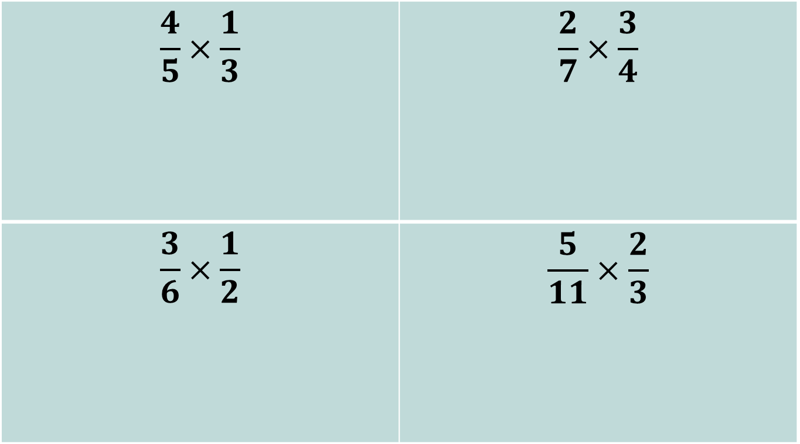
Practice Time! (LHS)
$$\frac{4}{5}×\frac{1}{3}$$ | $$\frac{2}{7}×\frac{3}{4}$$
$$\frac{3}{6}×\frac{1}{2}$$ | $$\frac{5}{11}×\frac{2}{3}$$

Slide 14
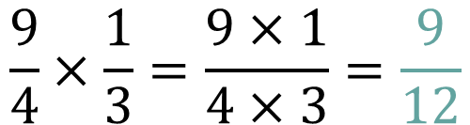

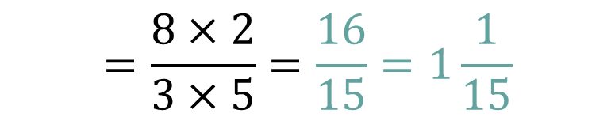
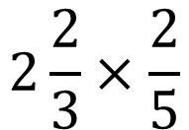
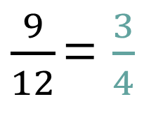
24
7
30
Topic: Multiplication
Date: 26/03/2021
EQ: How do I multiply fractions?
We can use the Algorithm Method for improper fractions and mixed numbers.
Algorithm for Improper Fractions
Same rule! Just more simplifying at the end!
$$\frac{9}{4}×\frac{1}{3}=\frac{9×1}{4×3}=\frac{9}{12}$$
simplified
$\frac{9}{12}$ = $\frac{3}{4}$
Algorithm for mixed numbers
Convert to improper fraction and follow the rule
$$2\frac{2}{3}×\frac{2}{5}$$
convert
$$=\frac{8×2}{3×5}=\frac{16}{15}=1\frac{1}{15}$$
$$\frac{8}{3}×\frac{2}{5}$$

Slide 15
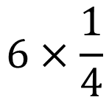
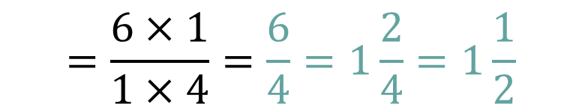
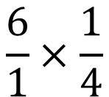
24
7
30
Topic: Multiplication
Date: 26/03/2021
EQ: How do I multiply fractions?
We can use the Algorithm Method for whole numbers being multiplied with fractions.
Algorithm Method for multiplying Whole Numbers and Fractions
Whole numbers can be written with a denominator of 1. This is because anything divided by 1 is itself.
$$6×\frac{1}{4}$$
convert
$$\frac{6}{1}×\frac{1}{4}$$
$$=\frac{6×1}{1×4}=\frac{6}{4}=1\frac{2}{4}=1\frac{1}{2}$$

Slide 16
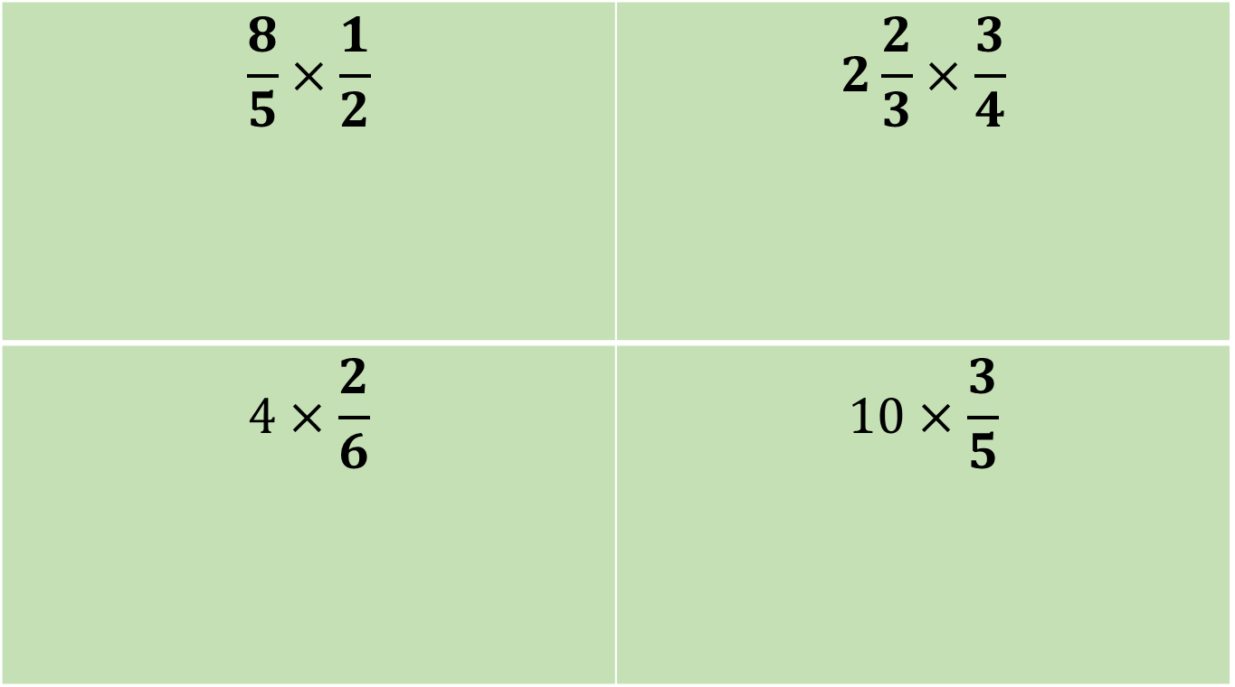
Practice Time!
On your left hand side
$$\frac{8}{5}×\frac{1}{2}$$ | $$2\frac{2}{3}×\frac{3}{4}$$
$$4×\frac{2}{6}$$ | $$10×\frac{3}{5}$$

Slide 17
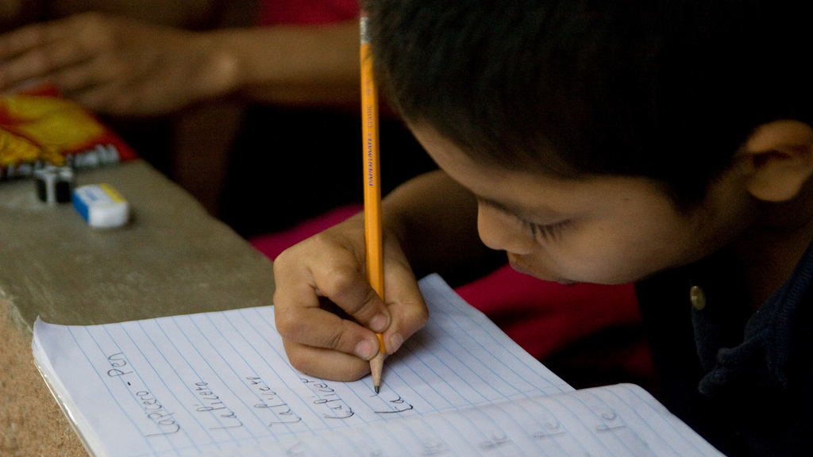
Write Your Summary
Write a summary that answers the Essential Question: How do I multiply fractions? Include an example in your answer.
This Photo by Unknown Author is licensed under CC BY-SA

